Slide 1
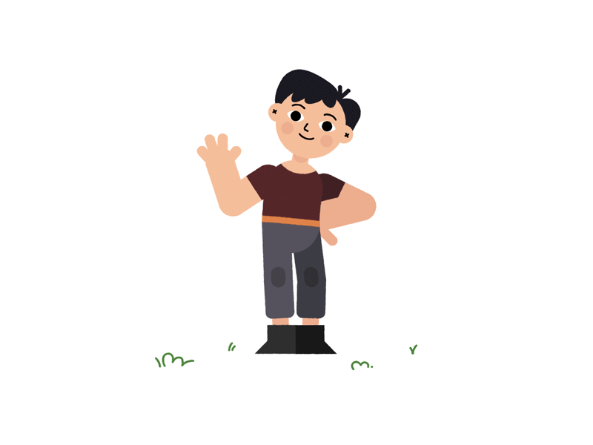
Children's Day Song
https://youtu.be/6RxLplB4iCU

Slide 2
Happy children, healthy children,
快樂 兒童 ， 健康 兒童
smile, smile, clap clap clap.
微笑、 微笑、 拍 拍 手

Slide 3
Happy children, healthy children,
快樂 兒童 ， 健康 兒童
smile, smile, clap clap clap.
微笑、 微笑、 拍 拍 手

Slide 4
We need an education,
我們 需要 教育
yes we do!
是的 我們需要!

Slide 5
We need food and water too.
我們 也需要 食物 和 水

Slide 6
All these things are important you see.
這一切都 很重要 如你所見

Slide 7
For children everywhere,
對於 每個地方的兒童
For you and me.
對於 你 跟 我

Slide 8
Happy children, healthy children,
smile, smile, clap clap clap.
Happy children, healthy children,
smile, smile, clap clap clap.
We need an education, yes we do!
We need food and water too.
All these things are important you see.
For children everywhere,
For you and me.

Slide 9
Happy children, healthy children, 快樂兒童，健康兒童
smile, smile, clap clap clap. 微笑、微笑、拍拍手
Happy children, healthy children, 快樂兒童，健康兒童
smile, smile, clap clap clap. 微笑、微笑、拍拍手
We need an education,我們需要教育，
yes we do!是的，我們需要!
We need food and water too. 我們也需要食物和水。
All these things are important you see. 這些如你所知都很重要
For children everywhere, 對於 每個地方的兒童
For you and me. 對於你跟我

