Slide 1
https://www.youtube.com/watch?v=NqO6UrI1sig
探「索」職業

Slide 2
clothesline
曬衣繩
clues
線索

Slide 4
Uniform
制服

Slide 5
Who is she?
She is a mail carrier.

Slide 6
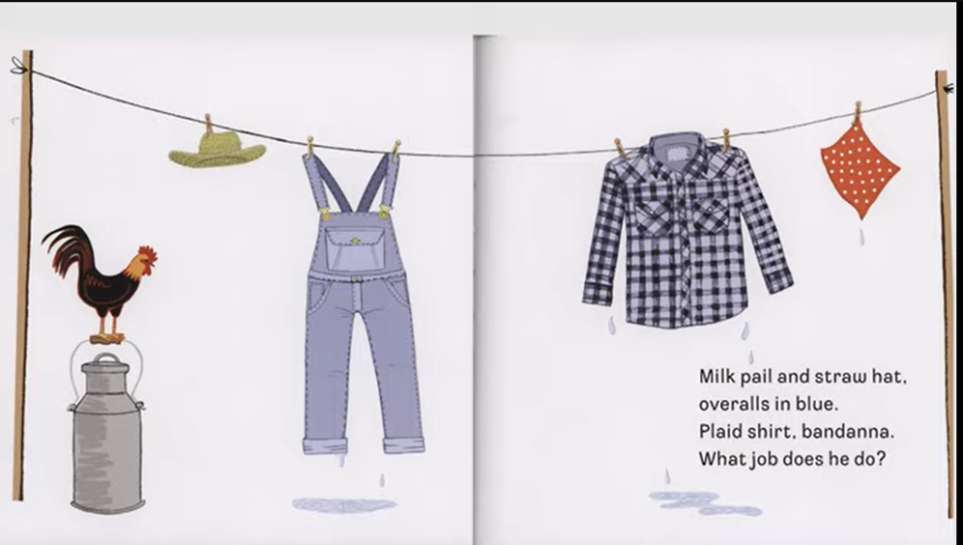
bandana 頭巾
straw hat 稻草帽
bandana 頭巾
banana
pail 桶子
plaid shirt 格子襯衫

Slide 7
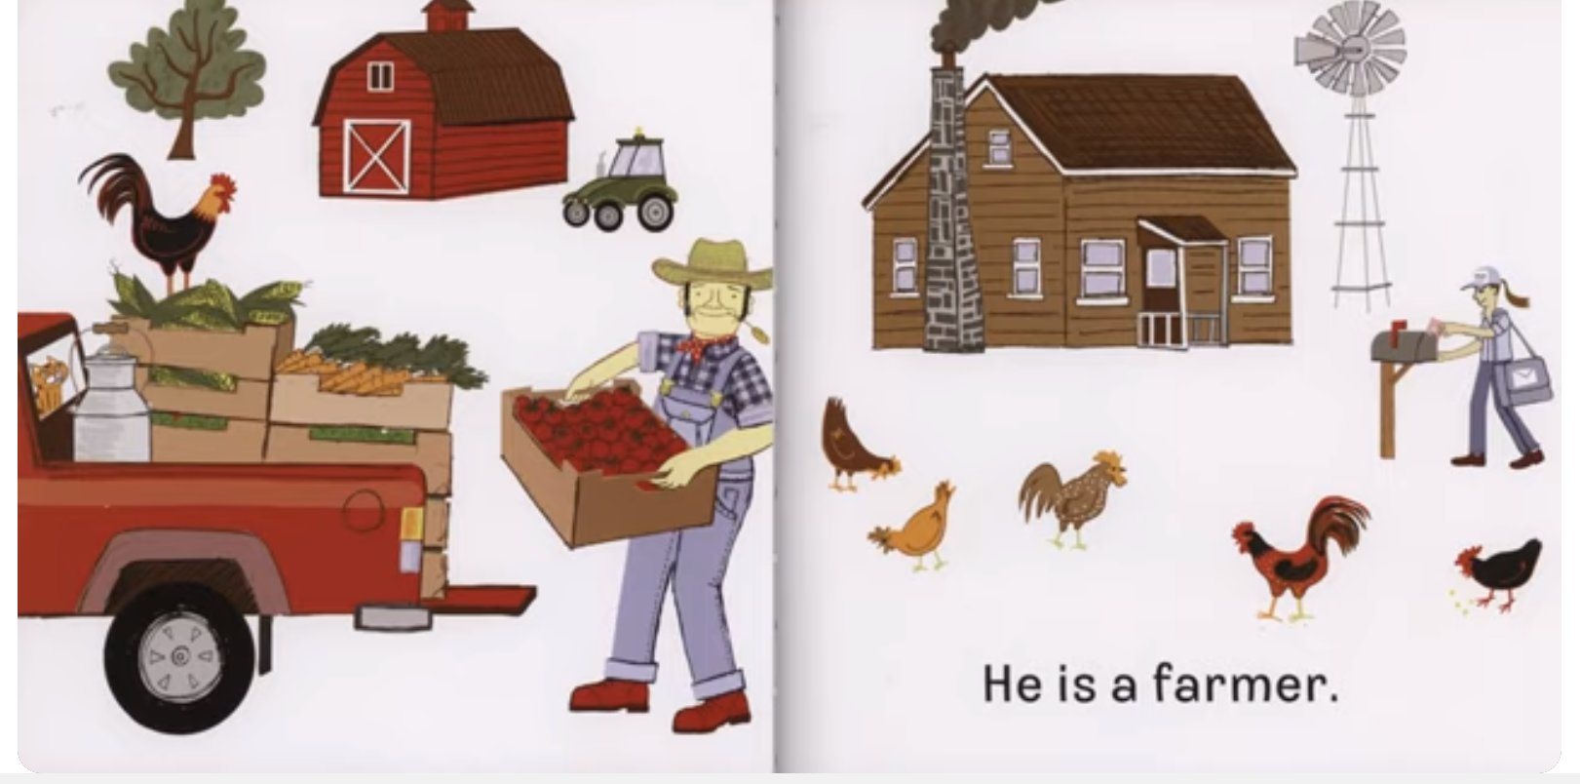
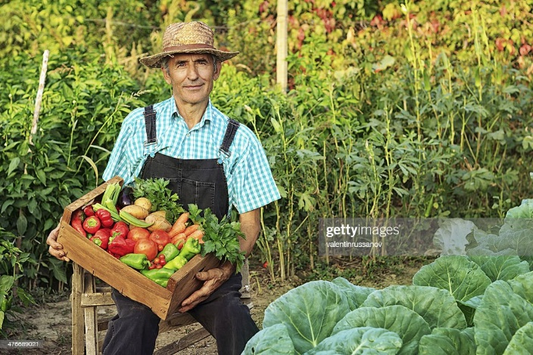
Who is he?
He is a farmer.

Slide 8
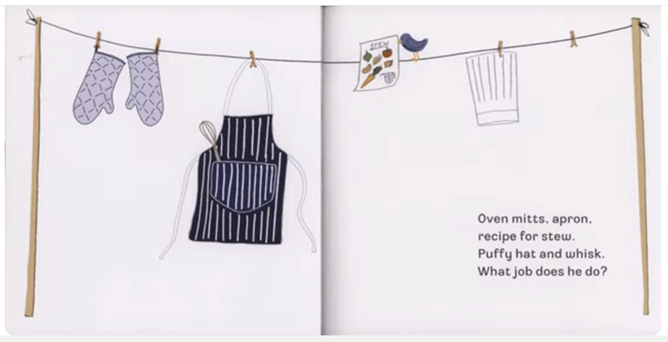
puffy hat
蓬鬆的帽子
recipe
食譜
apron
圍裙
oven mittens
烤箱手套

Slide 9
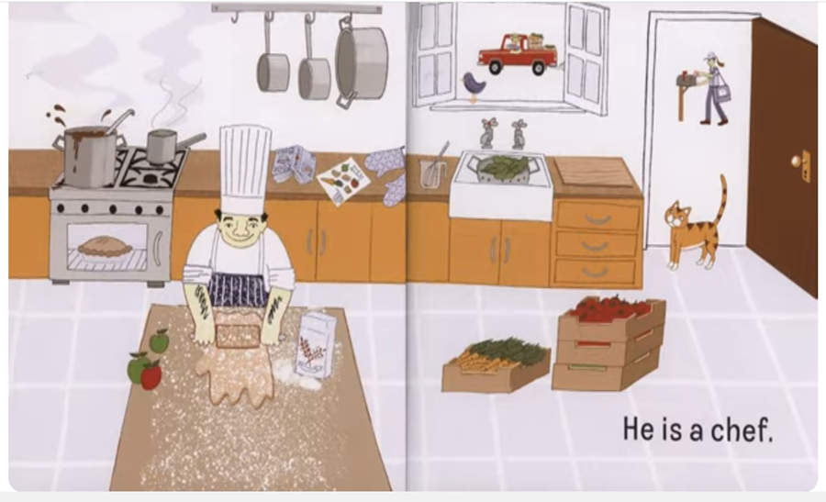
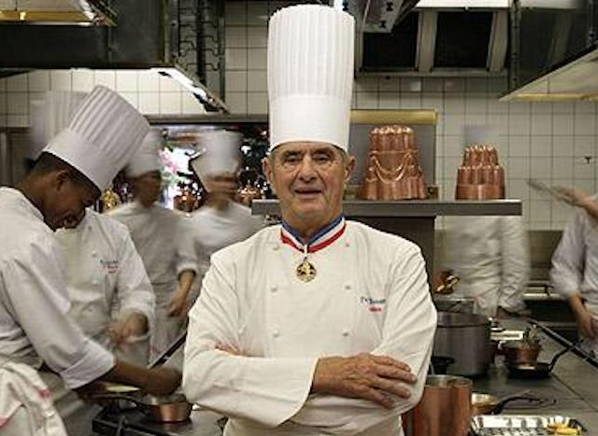
Who is he?
He is a chef.

Slide 10
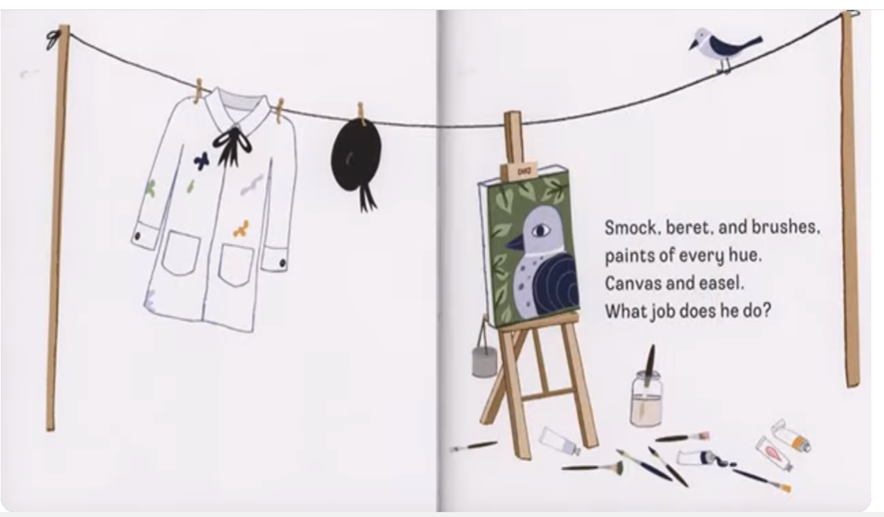
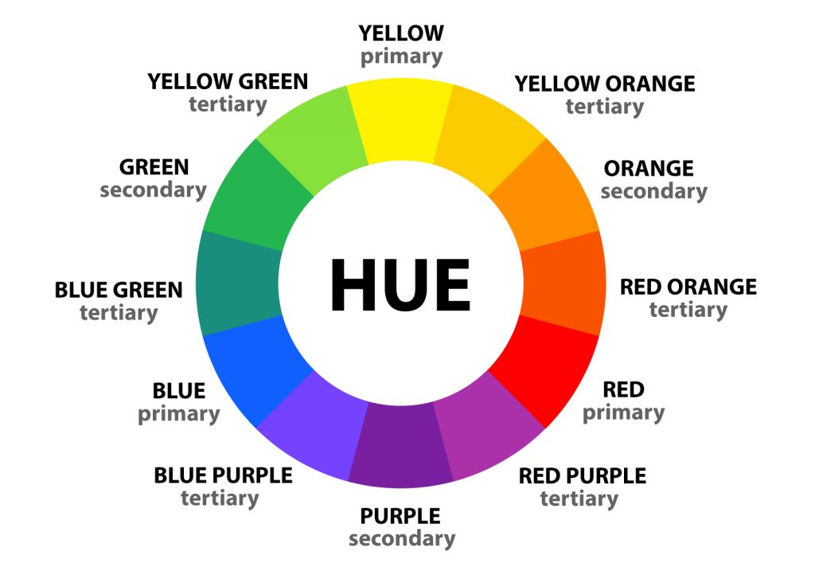
canvas
帆布
easel
畫架
hue
色調
beret
貝雷帽
smock
罩衫；工作服

Slide 11
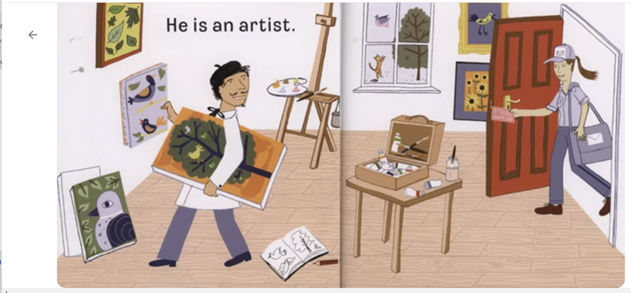
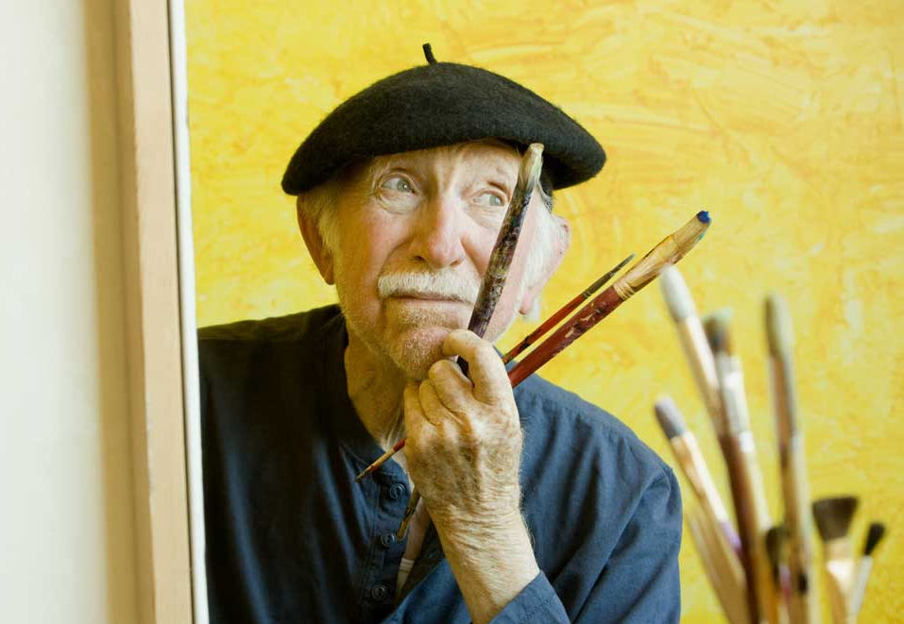
Who is he?
He is an artist.

Slide 12
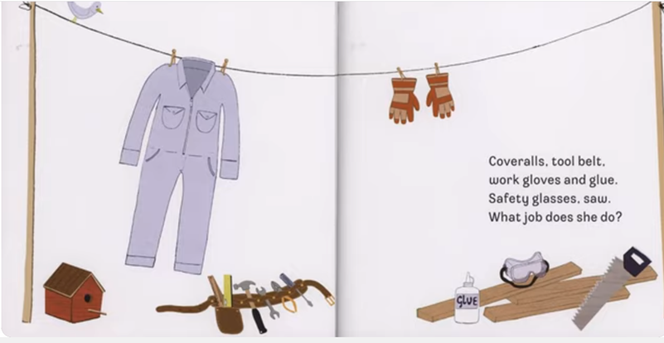
glove
手套
overall
連身工作服
鋸
safety glasses
護目鏡
saw
鋸子

Slide 13
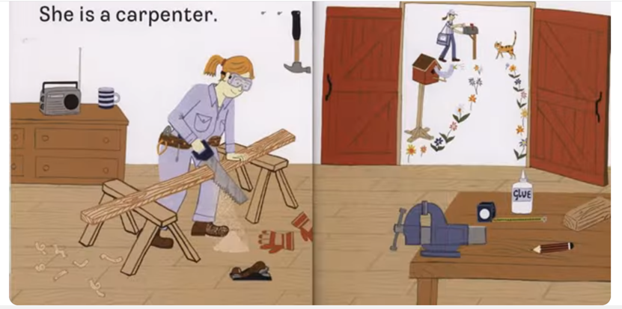
Who is she?
She is a carpenter.

Slide 14
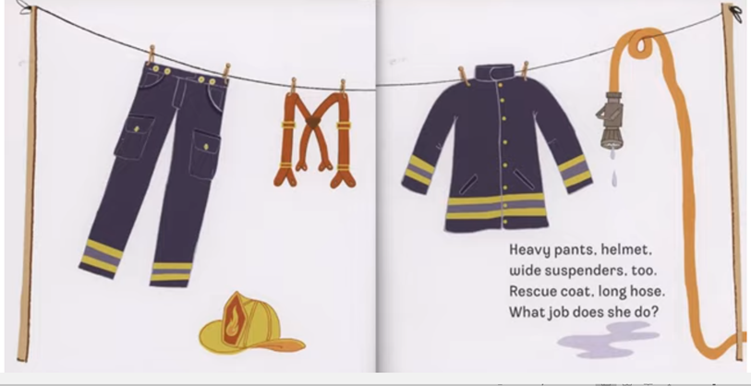
suspenders
褲吊帶
rescue coat
救助衣
hose
水管
helmet
安全帽

Slide 15
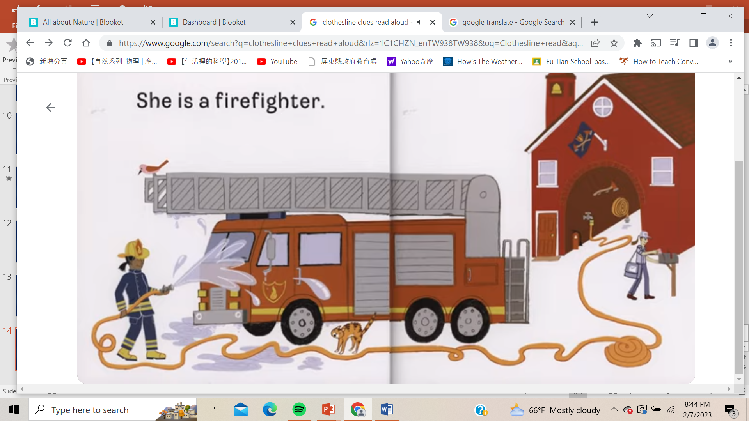
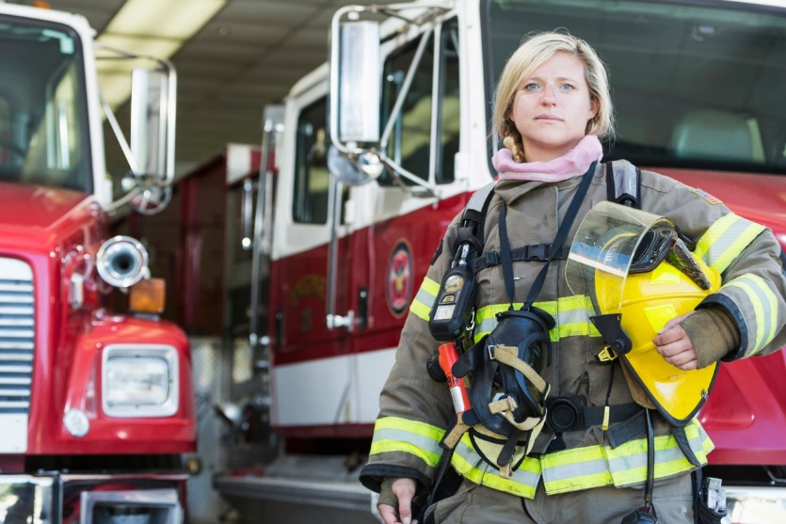
Who is she?
She is a firefighter.

Slide 16
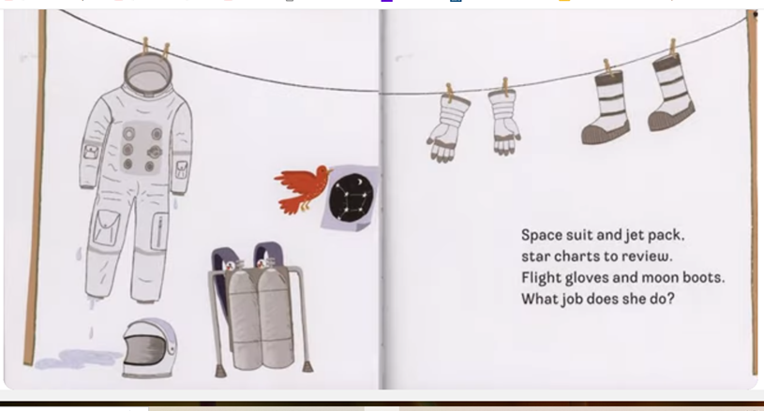
space suit太空服
moon boots
太空靴
flight gloves
飛行手套
jet pack
噴氣背包

Slide 17
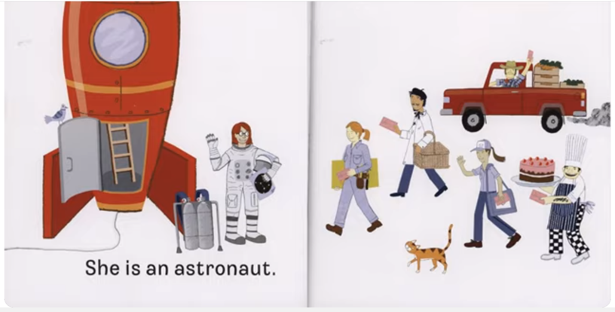
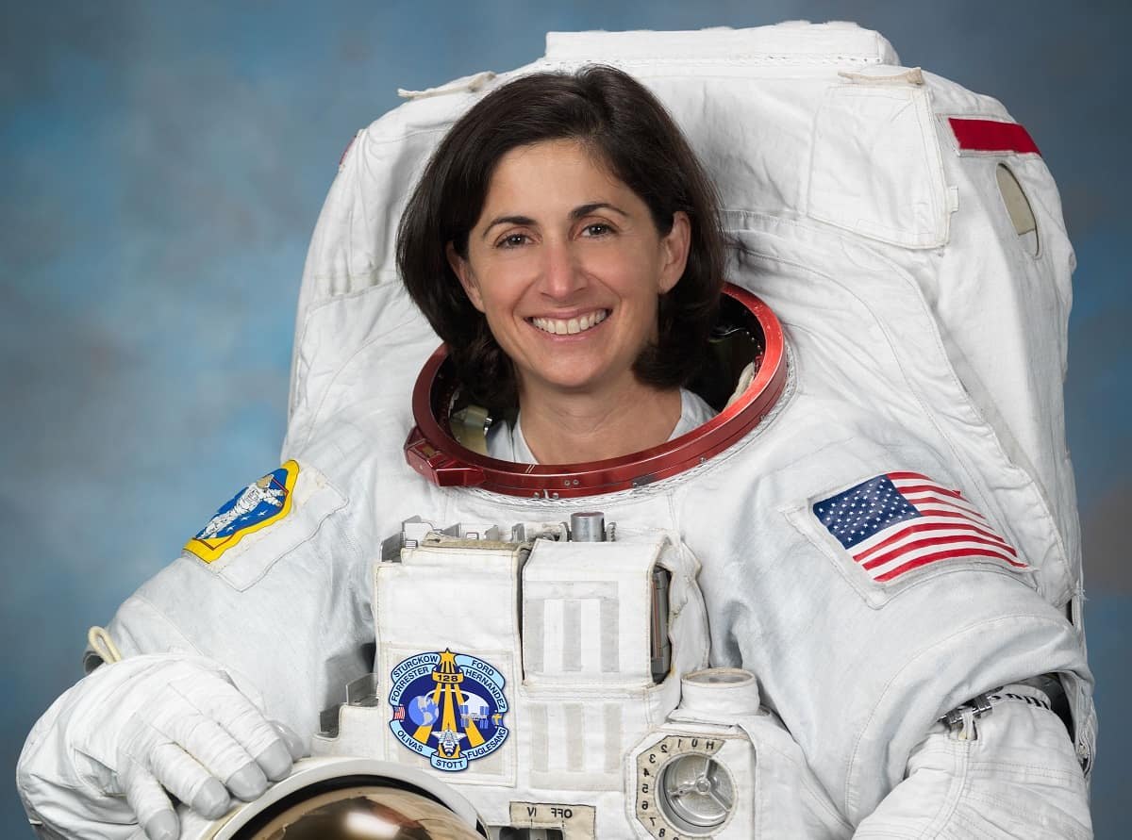
Who is she?
She is an astronaut.

